Slide 1
Unit-2: Medium Access Layer
Ashutosh Kumar Singh
www.ashutoshksingh.in

Slide 2
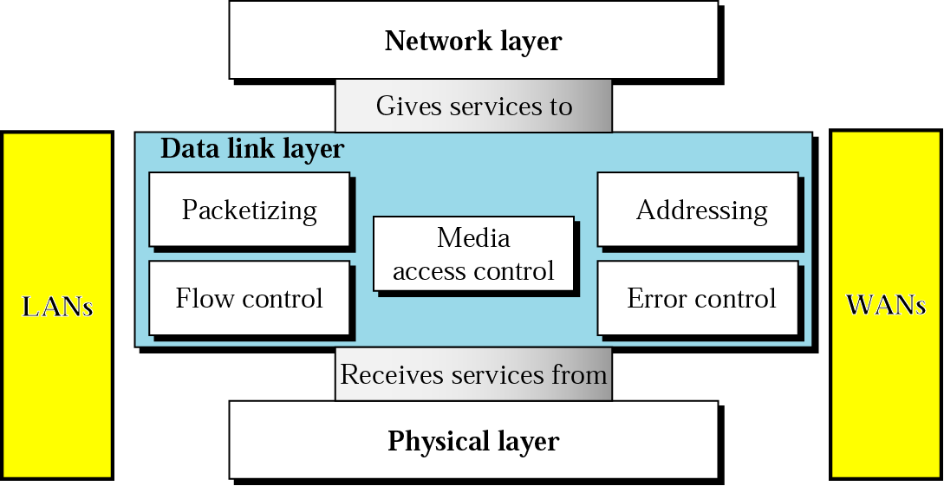
Data Link Layer

Slide 3
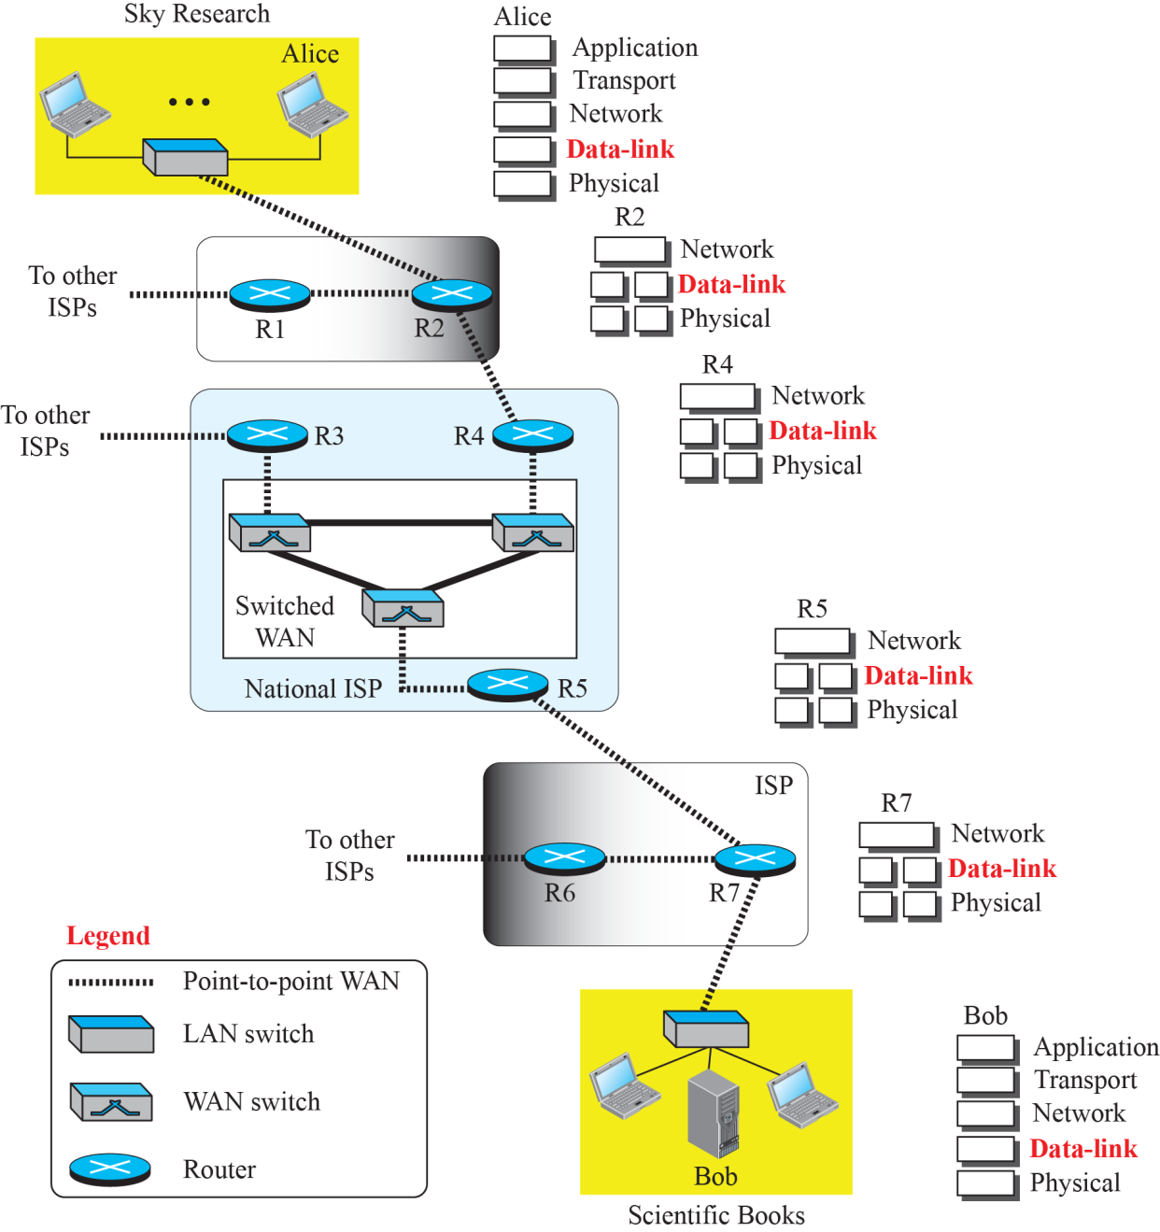
Figure 2.1: Communication at the data-link layer

Slide 4
2.1 Nodes and Links
Communication at the data-link layer is node-to-node.
A data unit from one point in the Internet needs to pass through many networks (LANs and WANs) to reach another point.
Theses LANs and WANs are connected by routers. It is customary to refer to the two end hosts and the routers as nodes and the networks in between as links.
Figure 9.2 is a simple representation of links and nodes when the path of the data unit is only six nodes.

Slide 5
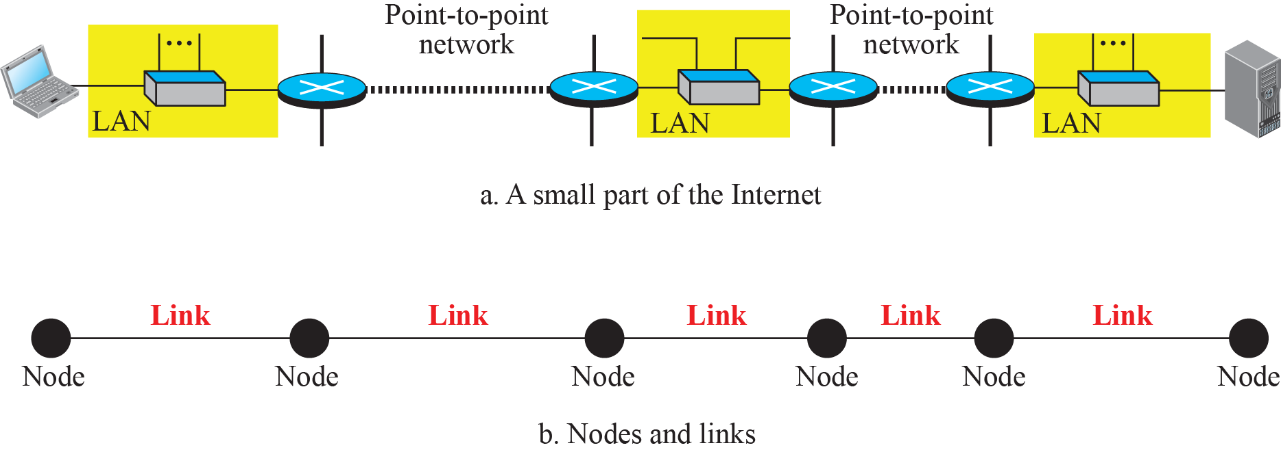
Figure 9.2: Nodes and Links

Slide 6
9.9.2 Services
The data-link layer is located between the physical and the network layers.
The data-link layer provides services to the network layer; it receives services from the physical layer.
Let us discuss services provided by the data-link layer.

Slide 7
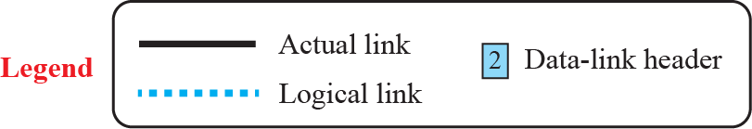
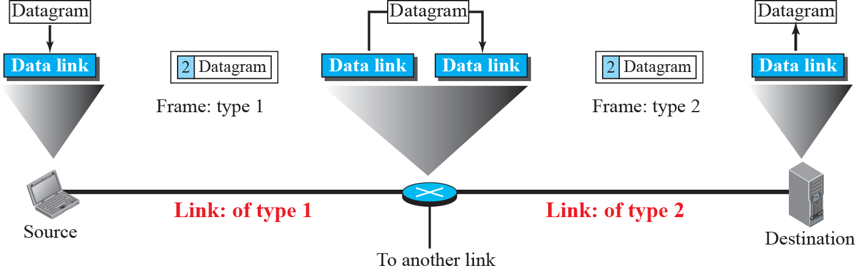
Figure 9.3: A communication with only three nodes

Slide 8
2.3 Two Categories of Links
Although two nodes are physically connected by a transmission medium such as cable or air, we need to remember that the data-link layer controls how the medium is used.
We can have a data-link layer that uses the whole capacity of the medium; we can also have a data-link layer that uses only part of the capacity of the link.
In other words, we can have a point-to-point link or a broadcast link.

Slide 9
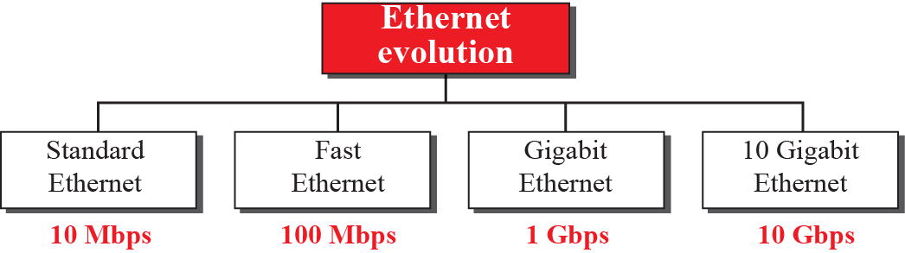
Figure 13.2 : Ethernet evolution

Slide 10
13-2 STANDARD ETHERNET
We refer to the original Ethernet technology with the data rate of 10 Mbps as the Standard Ethernet. Although most implementations have moved to other technologies in the Ethernet evolution, there are some features of the Standard Ethernet that have not changed during the evolution. We discuss this standard version first.

Slide 11
13.2.1 Characteristics
Let us first discuss some characteristics of the Standard Ethernet.

Slide 12
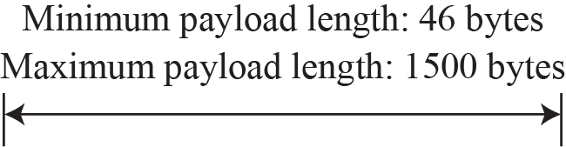
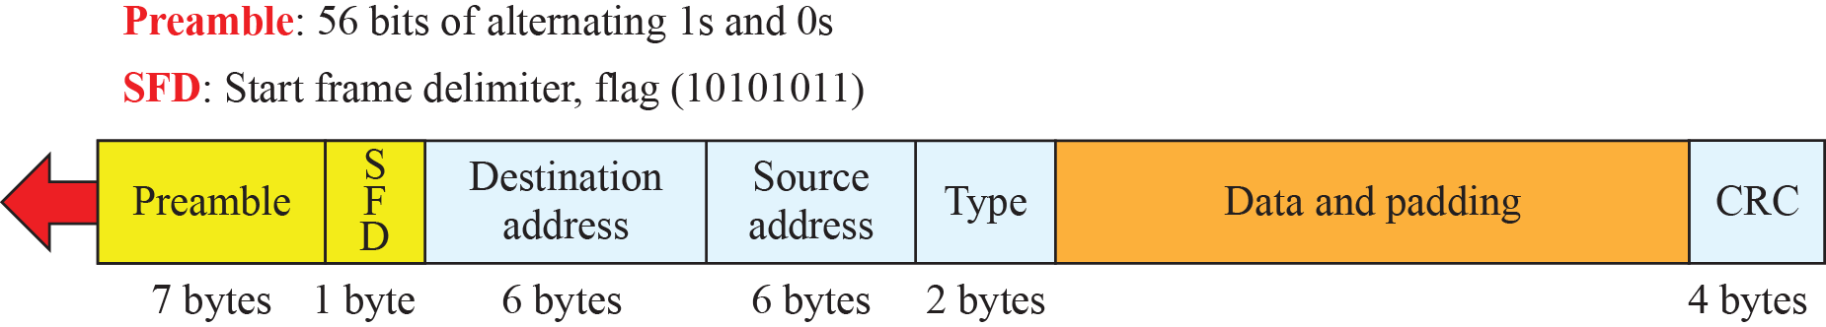
Figure 13.3: Ethernet frame

Slide 13
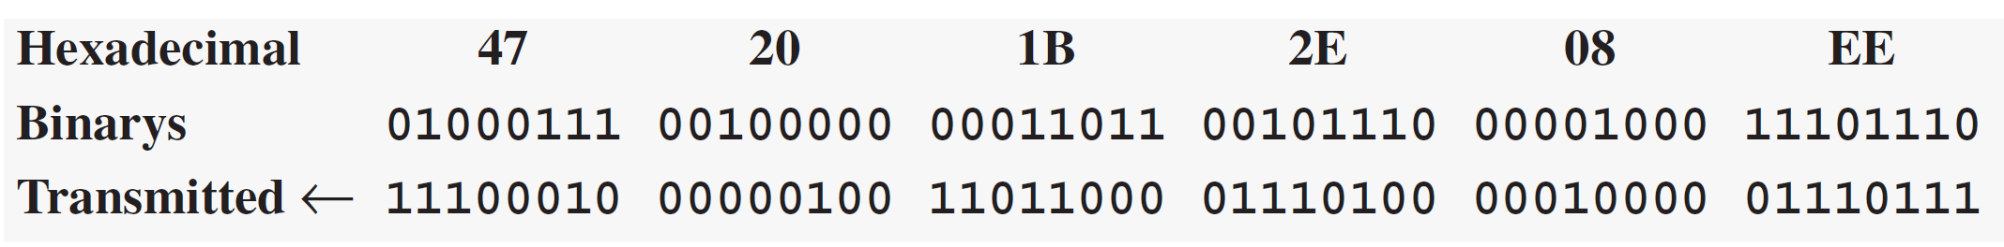
Example 13.1
Show how the address 47:20:1B:2E:08:EE is sent out online.
Solution
The address is sent left to right, byte by byte; for each byte, it is sent right to left, bit by bit, as shown below:
13.13

Slide 14
13.2.2 Addressing
Each station on an Ethernet network (such as a PC, workstation, or printer) has its own network interface card (NIC). The NIC fits inside the station and provides the station with a link-layer address. The Ethernet address is 6 bytes (48 bits), normally written in hexadecimal notation, with a colon between the bytes. For example, the following shows an Ethernet MAC address:

Slide 15
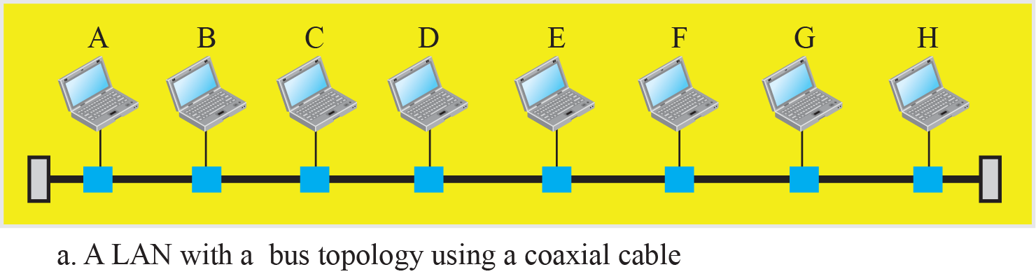
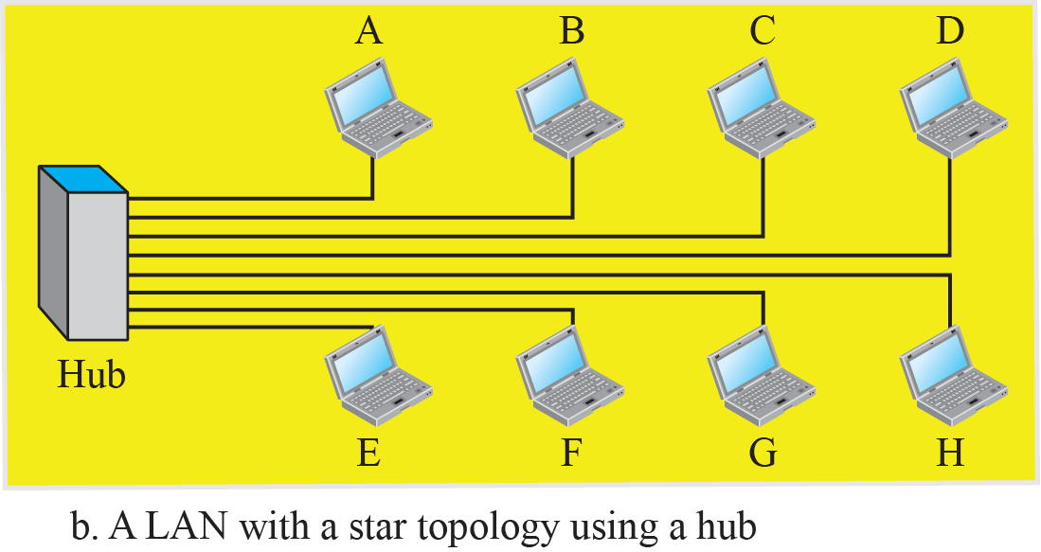
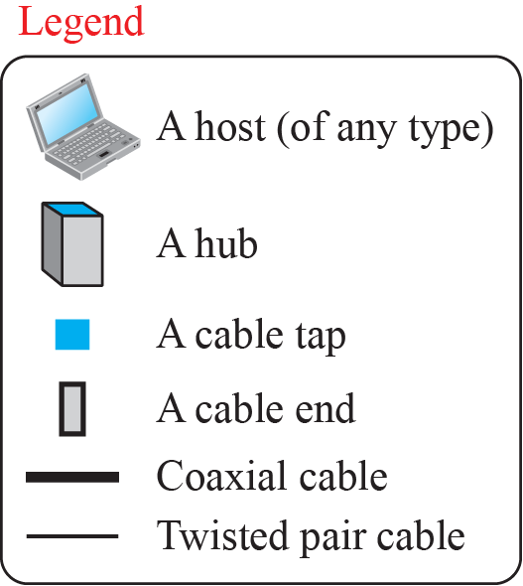
Figure 13.5: Implementation of standard Ethernet

Slide 16
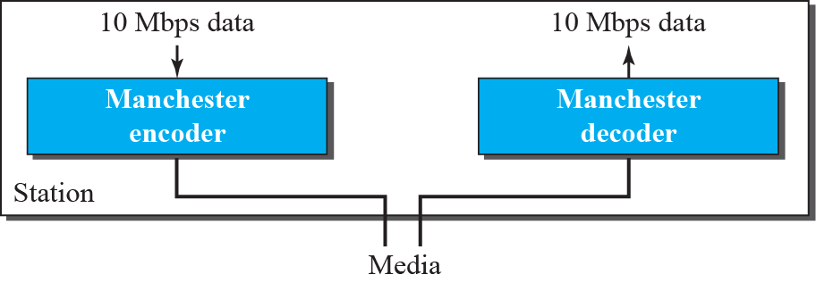
Figure 13.6: Encoding in a Standard Ethernet

Slide 17
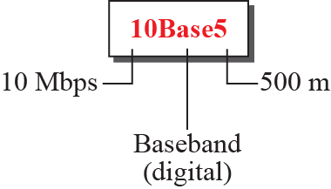
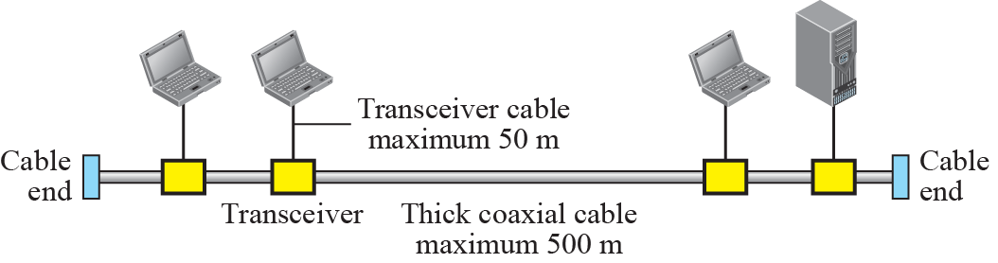
Figure 13.7: 10Base5 implementation

Slide 18
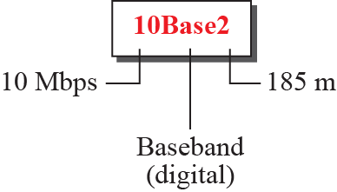
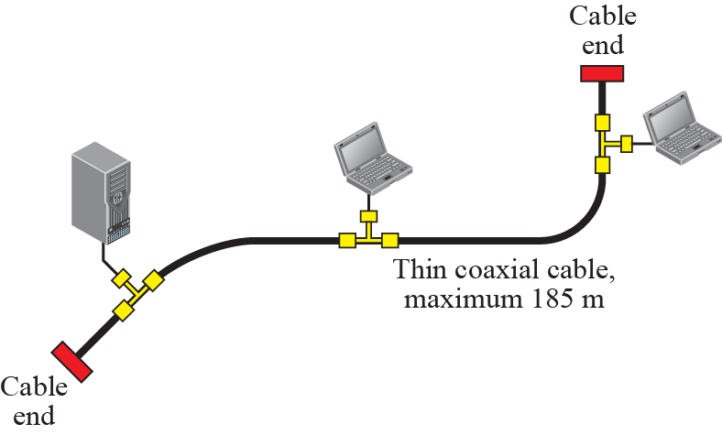
Figure 13.8: 10Base2 implementation

Slide 19
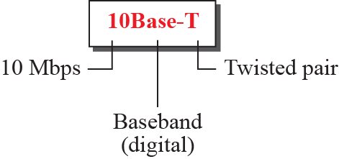
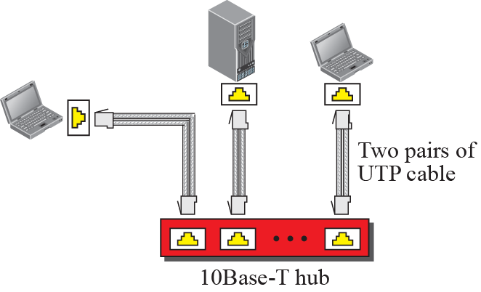
Figure 13.9: 10Base-T implementation

Slide 20
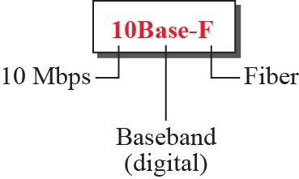
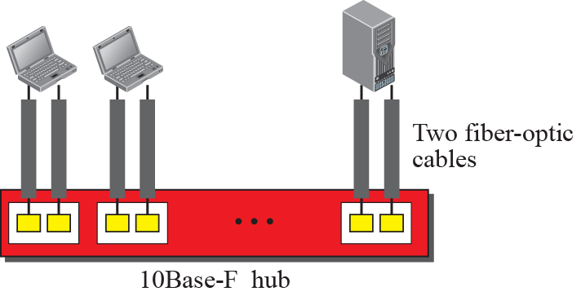
Figure 13.10: 10Base-F implementation

Slide 21
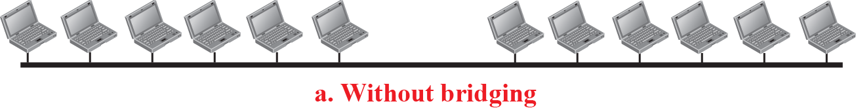
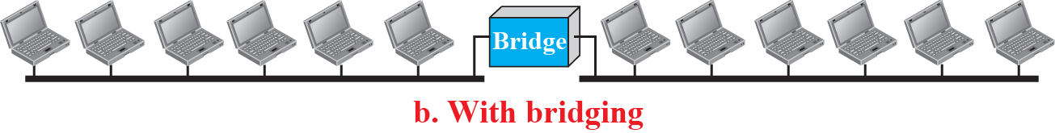
Figure 13.12: A network with and without bridging

Slide 22
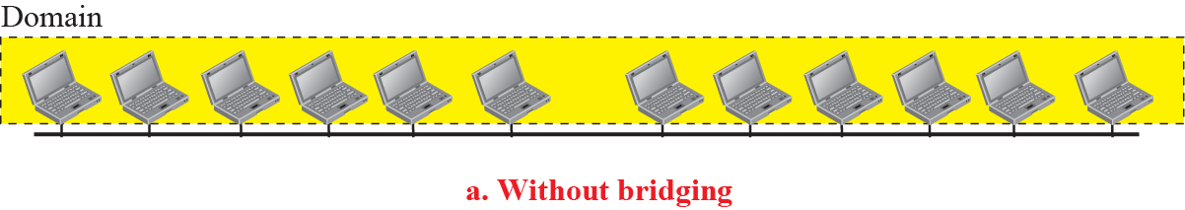
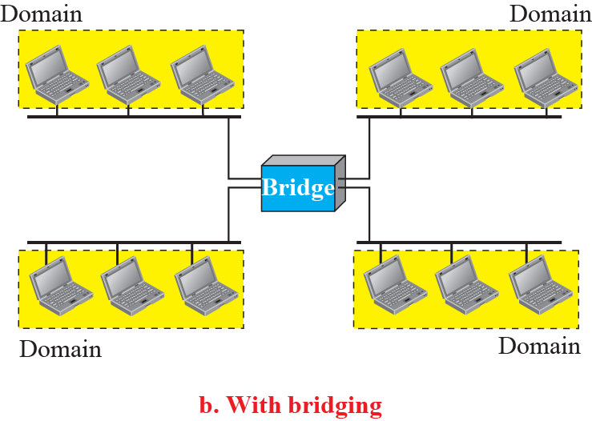
Figure 13.13: Collision domains

Slide 23
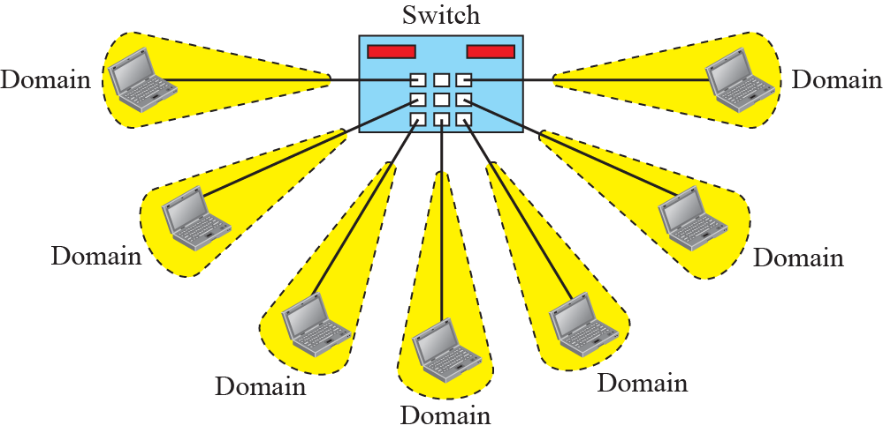
Figure 13.14: Switched Ethernet

Slide 24
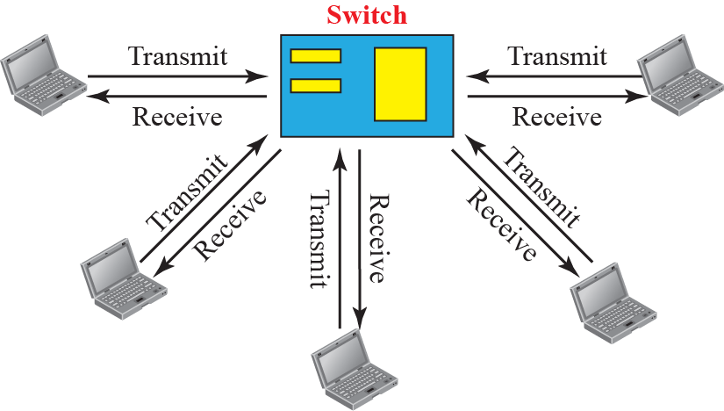
Figure 13.15: Full – duplex switched Ethernet

Slide 25
2.4 Two Sublayers
To better understand the functionality of and the services provided by the link layer, we can divide the data-link layer into two sub-layers:
data link control (DLC) and
media access control (MAC).
This is not unusual because, as we will see in later chapters, LAN protocols actually use the same strategy.

Slide 26
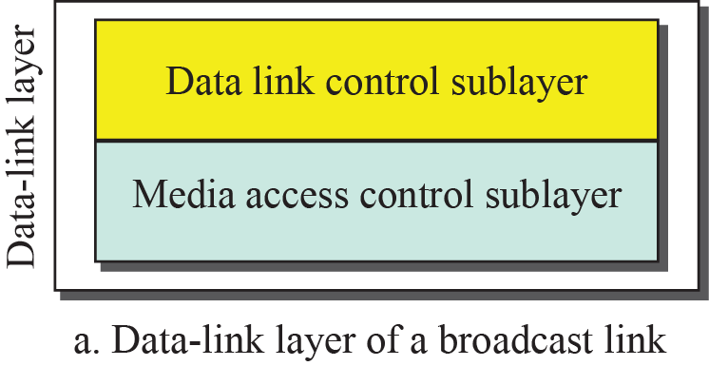
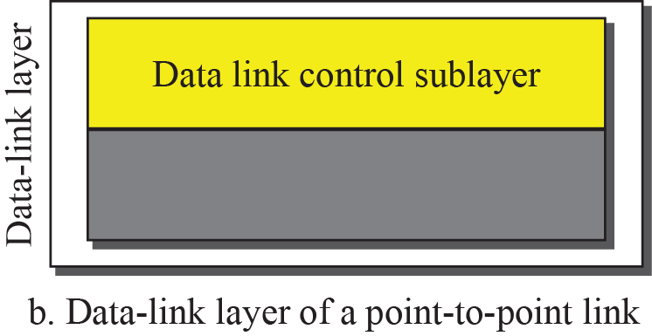
Figure 9.3: Dividing the data-link layer into two sublayers

Slide 27
LINK LAYER ADDRESSING
Link Layer Address is also called Physical address or Medium Access Control (MAC).
It is 48 bit address.
For example: A2:34:45:11:92:F1

Slide 28
9.2.1 Three Types of addresses
Some link-layer protocols define three types of addresses: unicast, multicast, and broadcast.

Slide 29
Example 9.1
The unicast link-layer addresses in the most common LAN, Ethernet, are 48 bits (six bytes) that are presented as 12 hexadecimal digits separated by colons. For example, the following is a link-layer address of a computer. The second digit needs to be an odd number.
A3:34:45:11:92:F1
9.29

Slide 30
Example 9.2
As we will see in Chapter 13, the multicast link-layer addresses in the most common LAN, Ethernet, are 48 bits (six bytes) that are presented as 12 hexadecimal digits separated by colons. The second digit, however, needs to be an even number in hexadecimal. The following shows a
multicast address:
A2:34:45:11:92:F1
9.30

Slide 31
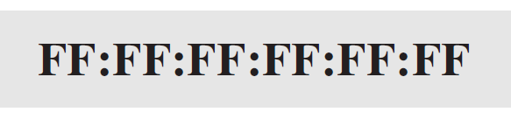
Example 9.3
As we will see in Chapter 13, the broadcast link-layer addresses in the most common LAN, Ethernet, are 48 bits, all 1s, that are presented as 12 hexadecimal digits separated by colons. The following shows a broadcast address:
9.31

Slide 32
9.2.2 ARP
Anytime a node has an IP datagram to send to another node in a link, it has the IP address of the receiving node. However, the IP address of the next node is not helpful in moving a frame through a link; we need the link-layer address of the next node. This is the time when the Address Resolution Protocol (ARP) becomes helpful.

Slide 33
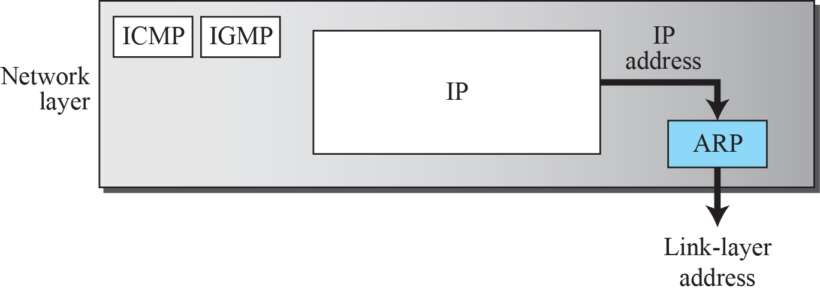
Figure 9.6: Position of ARP in TCP/IP protocol suite

Slide 34
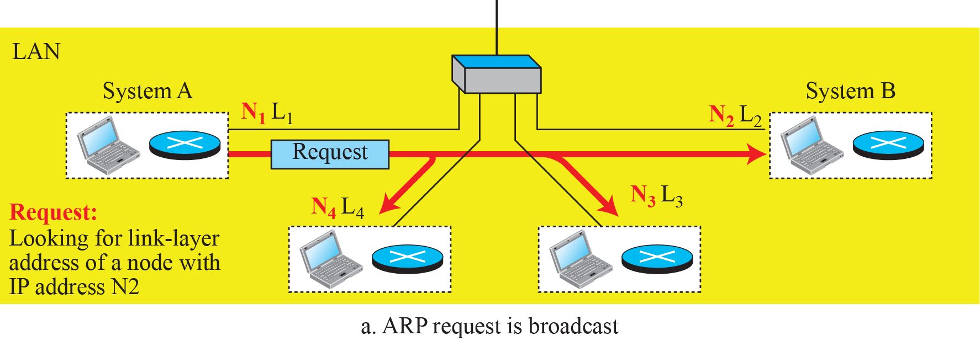
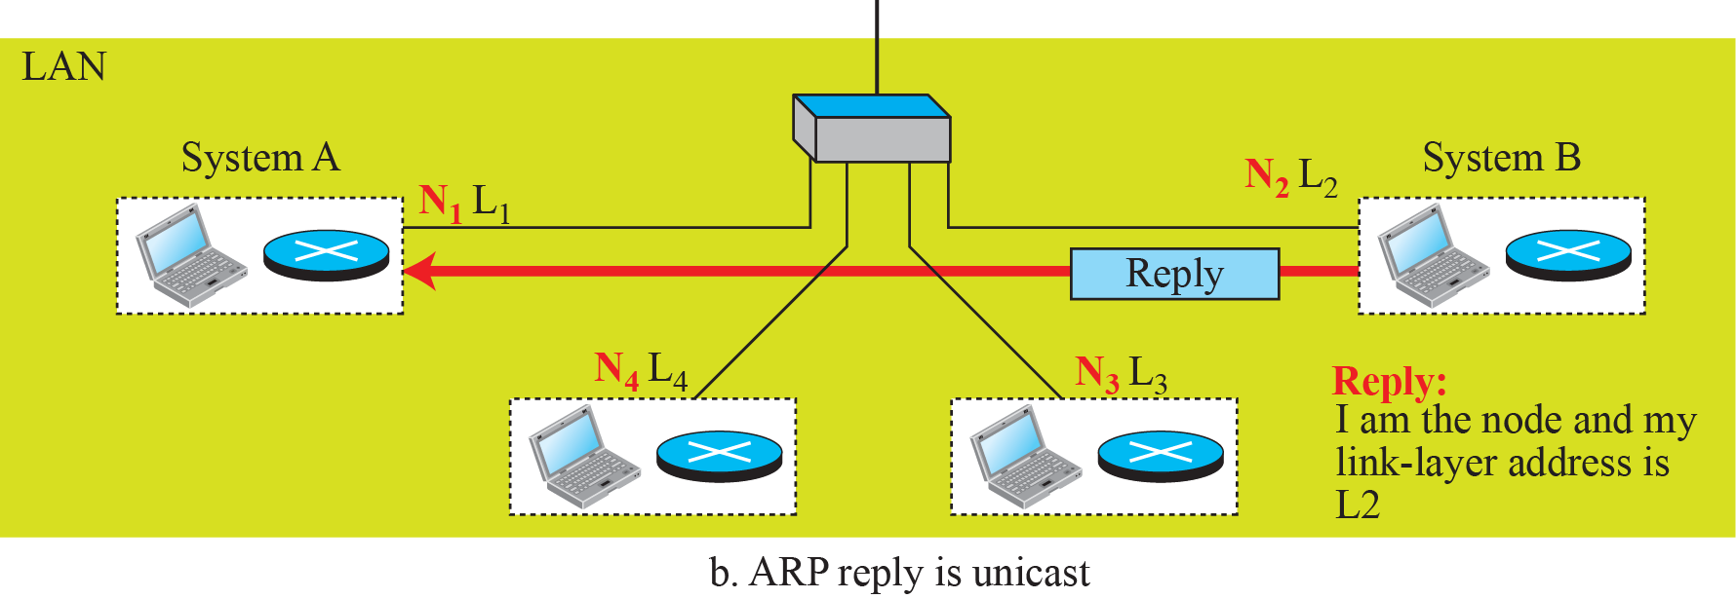
Figure 9.7: ARP operation

Slide 35
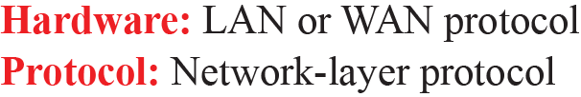
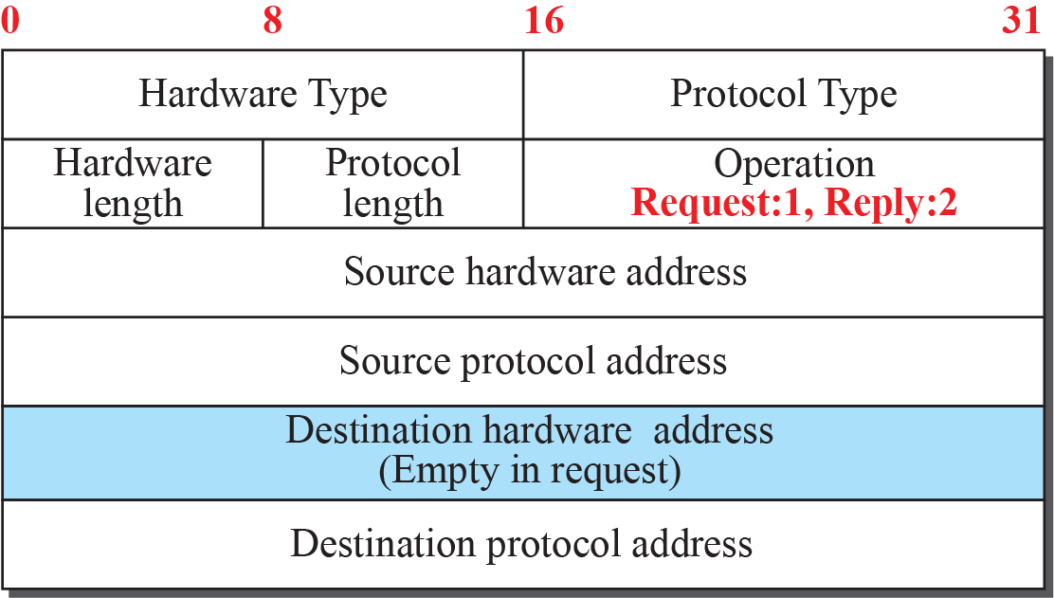
Figure 9.8: ARP packet

Slide 36
Example 9.4
A host with IP address N1 and MAC address L1 has a packet to send to another host with IP address N2 and physical address L2 (which is unknown to the first host). The two hosts are on the same network. Figure 9.9 shows the ARP request and response messages.
9.36

Slide 37
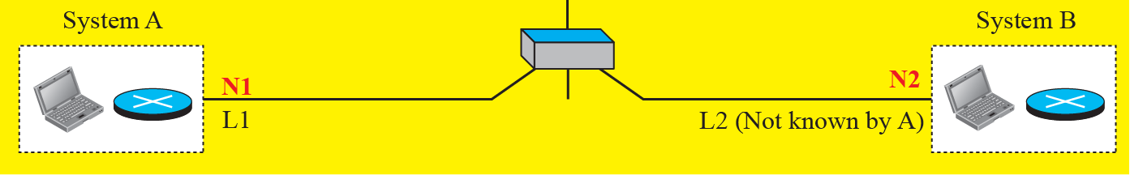
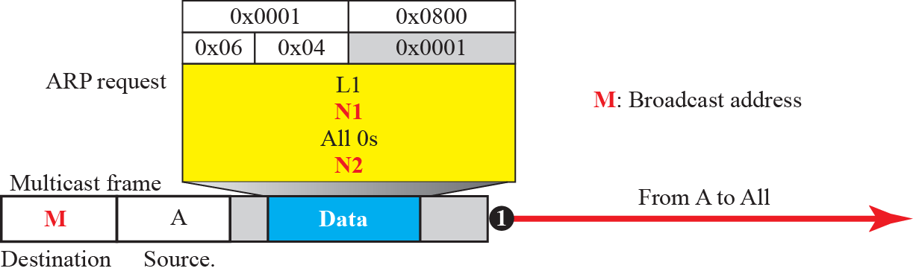
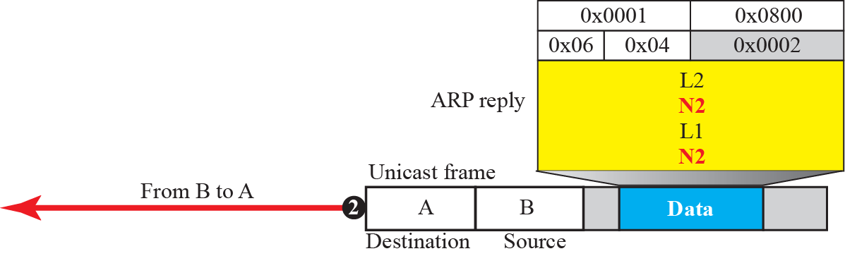
Figure 9.9: Example 9.4

Slide 38
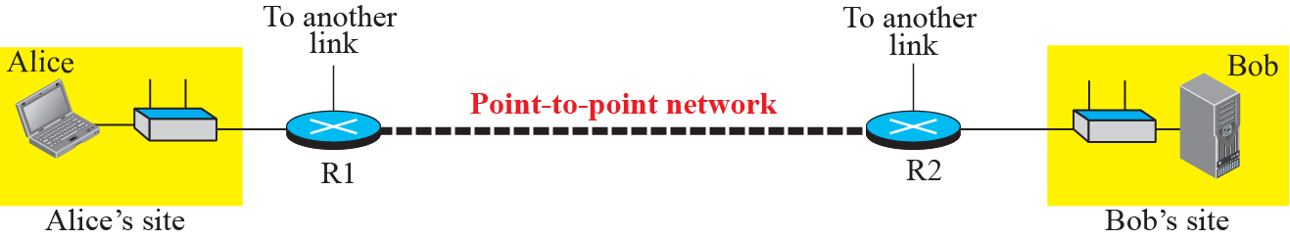
Figure 9.10: The internet for our example

Slide 39
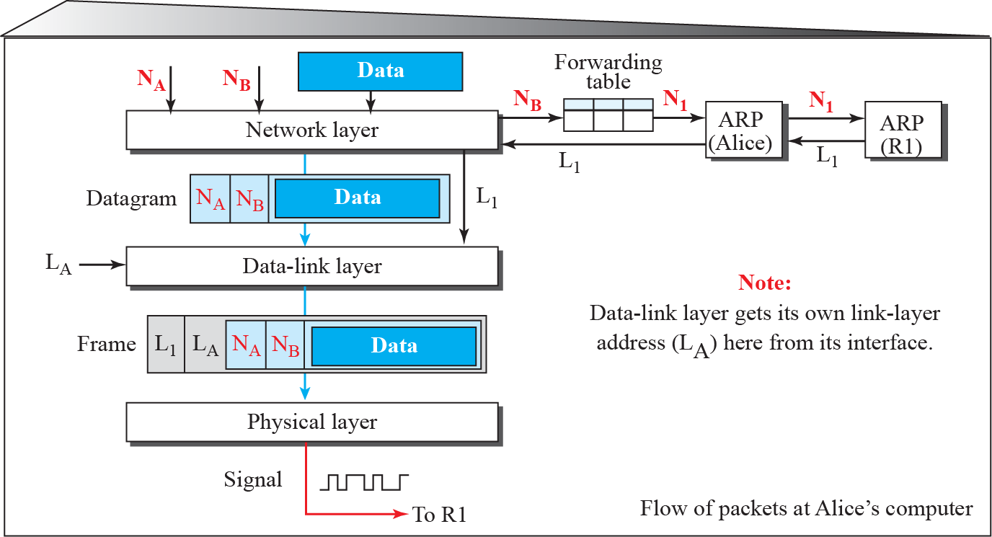
Figure 9.11: Flow of packets at Alice site

Slide 40
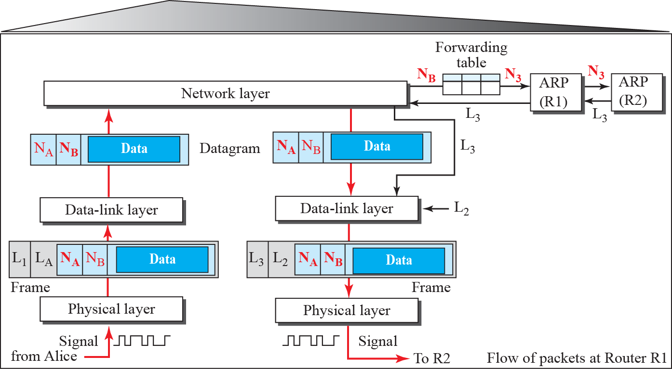
Figure 9.12: Flow of activities at router R1

Slide 41
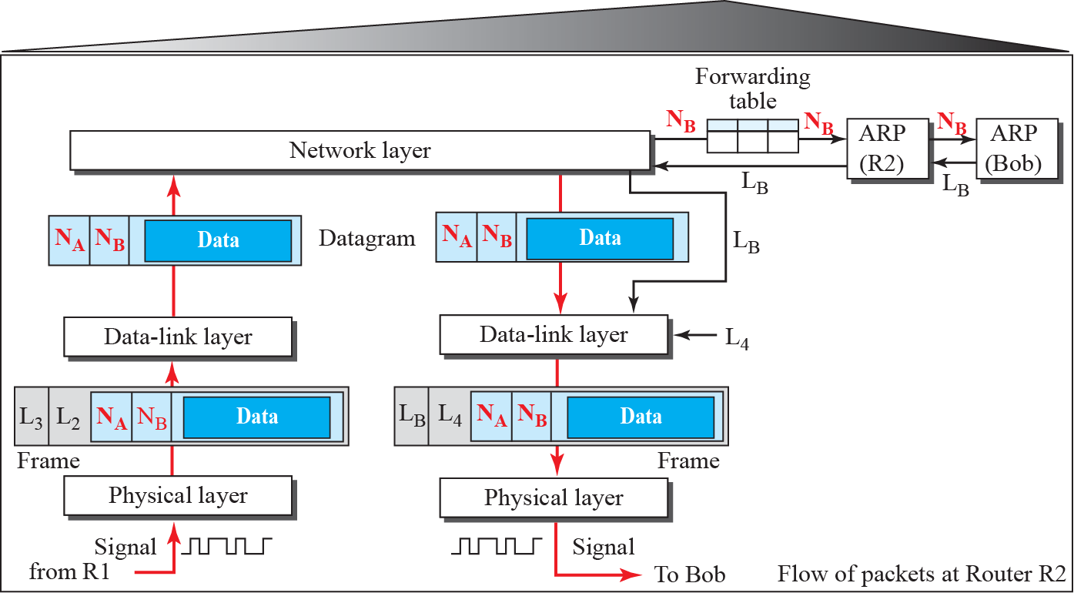
Figure 9.13: Flow of activities at router R2

Slide 42
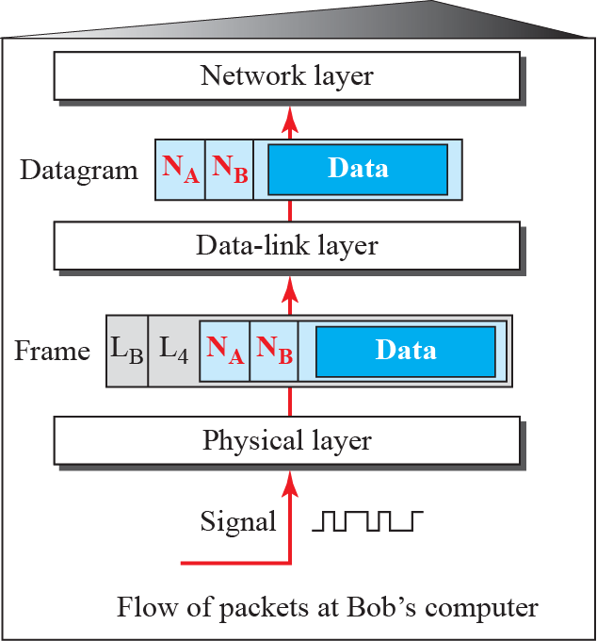
Figure 9.14: Activities at Bob’s site

Slide 43
FRAMING
Framing in the data link layer divides a message from one source to a destination by adding a sender address and a destination address.
The destination address defines where the packet is to go; the sender address helps the recipient acknowledge the receipt.

Slide 44
FRAMING
Fixed-Size Framing:
There is no need for defining the boundaries of the frames; the size itself can be used as a delimiter.
An example of this type of framing is the ATM wide-area network, which uses frames of fixed size called cells.

Slide 45
Variable-Size Framing:
We need a way to define the end of the frame and the beginning of the next.
An example : two approaches were used for this purpose: a character-oriented approach and a bit-oriented approach

Slide 46
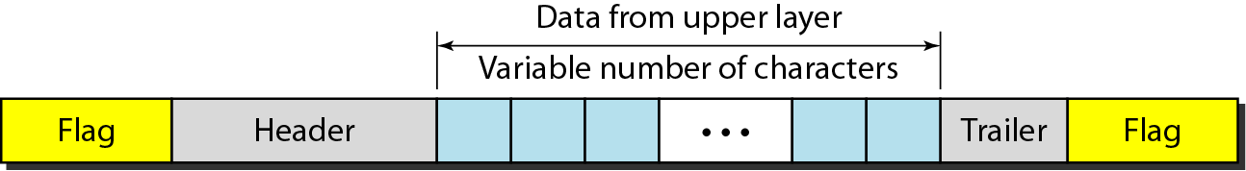
Figure 11.1 A frame in a character-oriented protocol

Slide 47
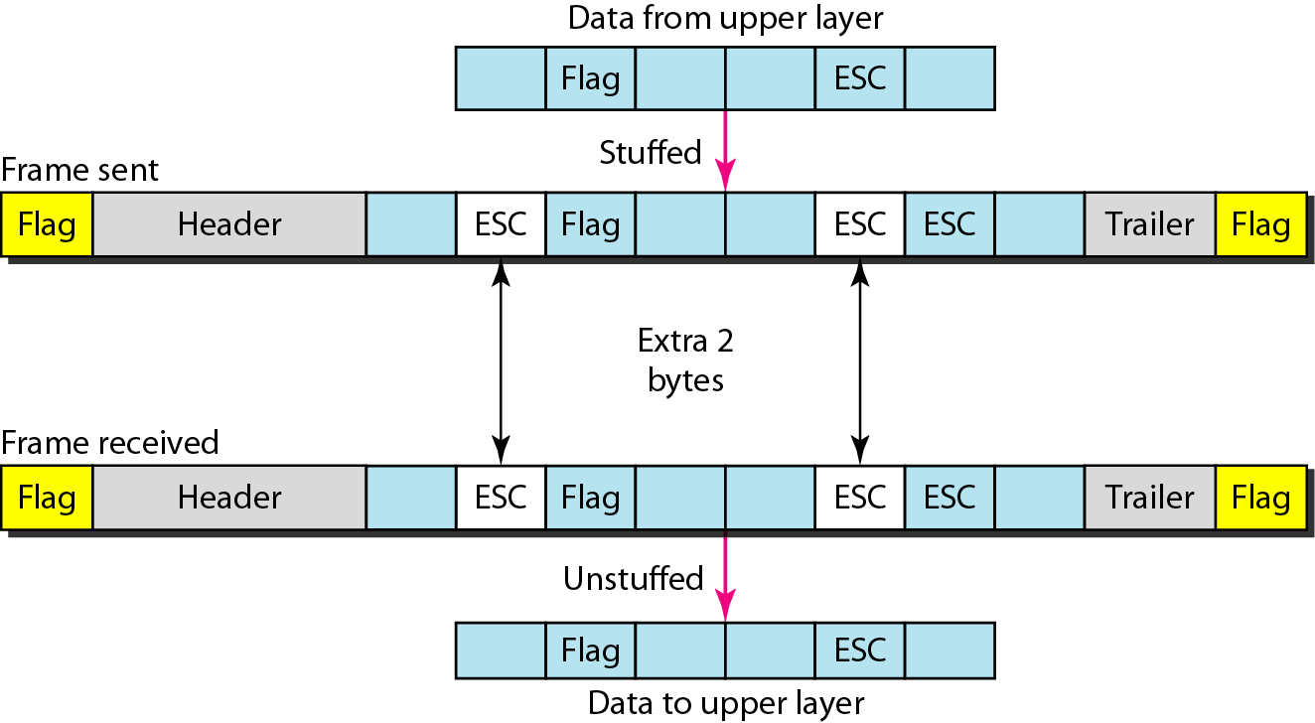
Figure 11.2 Byte stuffing and unstuffing

Slide 48

Note
Byte stuffing is the process of adding 1 extra byte whenever there is a flag or escape character in the text.

Slide 49
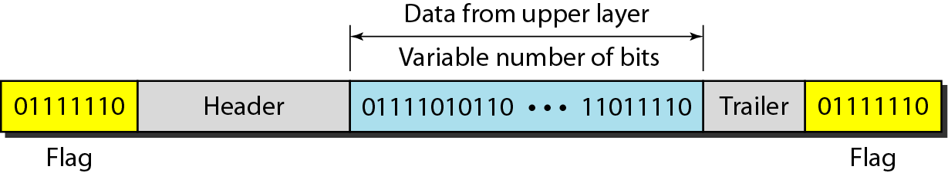
Figure 11.3 A frame in a bit-oriented protocol

Slide 50
Note
Bit stuffing is the process of adding one extra 0 whenever five consecutive 1s follow a 0 in the data, so that the receiver does not mistake
the pattern 0111110 for a flag.

Slide 51
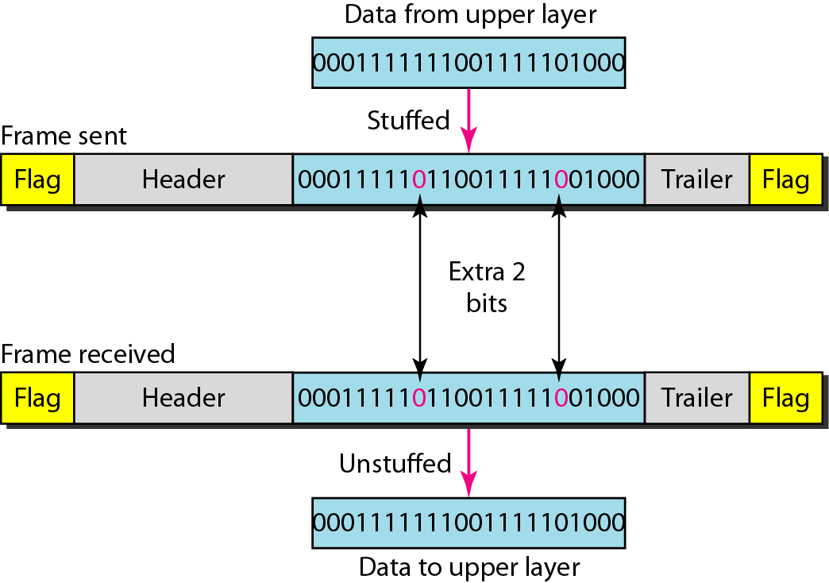
Figure 11.4 Bit stuffing and unstuffing

Slide 52
Flow control refers to a set of procedures used to restrict the amount of data
that the sender can send before
waiting for acknowledgment.

Slide 53
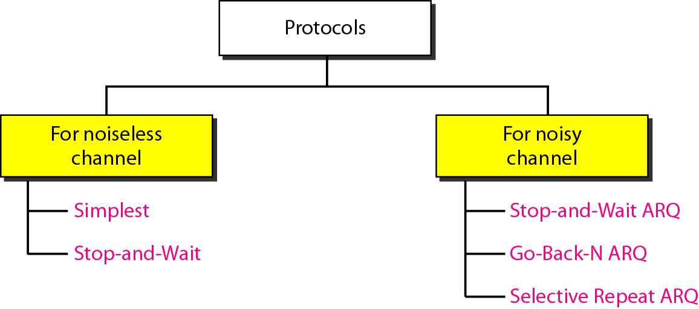
Figure 11.5 Taxonomy of protocols discussed in this chapter

Slide 54
11-4 NOISELESS CHANNELS
Let us first assume we have an ideal channel in which no frames are lost, duplicated, or corrupted. We introduce two protocols for this type of channel.
Topics discussed in this section:
Simplest Protocol Stop-and-Wait Protocol

Slide 55
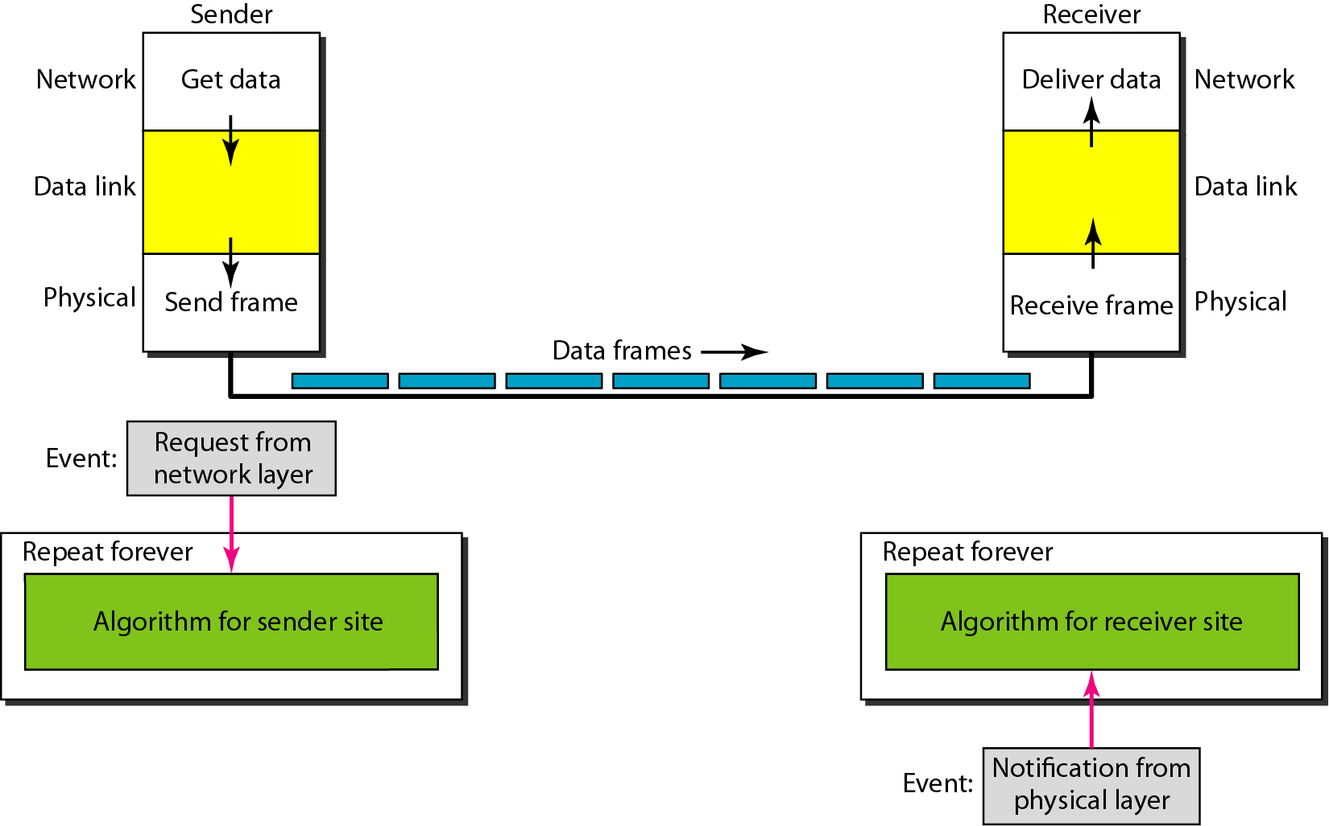
Figure 11.6 The design of the simplest protocol with no flow or error control

Slide 56
Example 11.1
Figure 11.7 shows an example of communication using this protocol. It is very simple. The sender sends a sequence of frames without even thinking about the receiver. To send three frames, three events occur at the sender site and three events at the receiver site. Note that the data frames are shown by tilted boxes; the height of the box defines the transmission time difference between
the first bit and the last bit in the frame.

Slide 57
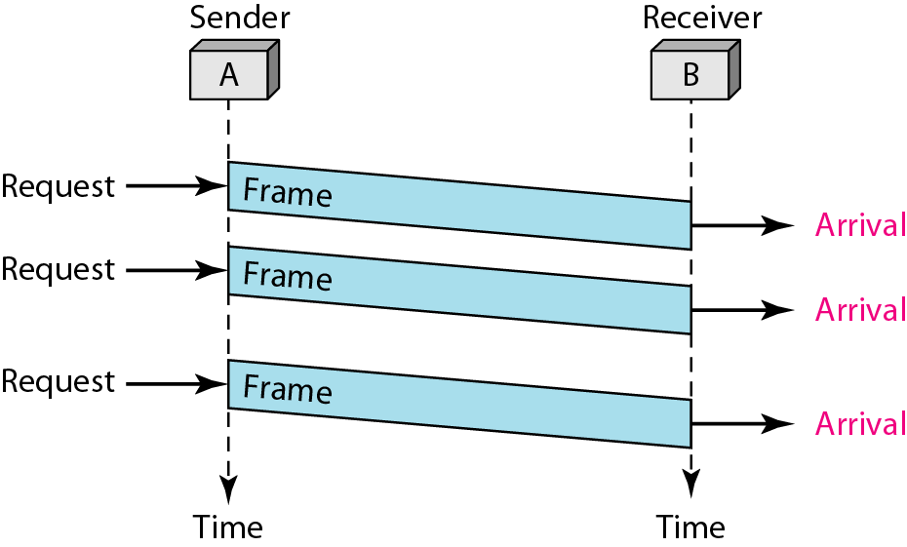
Figure 11.7 Flow diagram for Example 11.1

Slide 58

Figure 11.8 Design of Stop-and-Wait Protocol

Slide 59
Example 11.2
Figure 11.9 shows an example of communication using this protocol. It is still very simple. The sender sends one frame and waits for feedback from the receiver. When the ACK arrives, the sender sends the next frame. Note that sending two frames in the protocol involves the sender in four events and the receiver in two events.

Slide 60

Figure 11.9 Flow diagram for Example 11.2

Slide 61
11-5 NOISY CHANNELS
Although the Stop-and-Wait Protocol gives us an idea of how to add flow control to its predecessor, noiseless channels are nonexistent. We discuss three protocols in this section that use error control.
Topics discussed in this section:
Stop-and-Wait Automatic Repeat Request Go-Back-N Automatic Repeat Request Selective Repeat Automatic Repeat Request

Slide 62
Note
Error correction in Stop-and-Wait ARQ is done by keeping a copy of the sent frame and retransmitting of the frame when the timer expires.

Slide 63
Note
In Stop-and-Wait ARQ, we use sequence numbers to number the frames.
The sequence numbers are based on modulo-2 arithmetic.

Slide 64
Note
In Stop-and-Wait ARQ, the acknowledgment number always announces in modulo-2 arithmetic the sequence number of the next frame expected.

Slide 65

Figure 11.10 Design of the Stop-and-Wait ARQ Protocol

Slide 66
Example 11.3
Figure 11.11 shows an example of Stop-and-Wait ARQ. Frame 0 is sent and acknowledged. Frame 1 is lost and resent after the time-out. The resent frame 1 is acknowledged and the timer stops. Frame 0 is sent and acknowledged, but the acknowledgment is lost. The sender has no idea if the frame or the acknowledgment is lost, so after the time-out, it resends frame 0, which is acknowledged.

Slide 67

Figure 11.11 Flow diagram for Example 11.3

Slide 68
Example 11.4
Assume that, in a Stop-and-Wait ARQ system, the bandwidth of the line is 1 Mbps, and 1 bit takes 20 ms to make a round trip. What is the bandwidth-delay product? If the system data frames are 1000 bits in length, what is the utilization percentage of the link?
Solution
The bandwidth-delay product is

Slide 69
Example 11.4 (continued)
The system can send 20,000 bits during the time it takes for the data to go from the sender to the receiver and then back again. However, the system sends only 1000 bits. We can say that the link utilization is only 1000/20,000, or 5 percent. For this reason, for a link with a high bandwidth or long delay, the use of Stop-and-Wait ARQ wastes the capacity of the link.

Slide 70
Example 11.5
What is the utilization percentage of the link in Example 11.4 if we have a protocol that can send up to 15 frames before stopping and worrying about the acknowledgments?
Solution
The bandwidth-delay product is still 20,000 bits. The system can send up to 15 frames or 15,000 bits during a round trip. This means the utilization is 15,000/20,000, or 75 percent. Of course, if there are damaged frames, the utilization percentage is much less because frames have to be resent.

Slide 71
Note
In the Go-Back-N Protocol, the sequence numbers are modulo 2^{m},
where m is the size of the sequence number field in bits.

Slide 72
Note
The send window is an abstract concept defining an imaginary box of size 2^{m} − 1 with three variables: Sf, Sn, and S_{size}.

Slide 73
Note
The send window can slide one or more slots when a valid acknowledgment arrives.

Slide 74

Figure 11.13 Receive window for Go-Back-N ARQ

Slide 75
The receive window is an abstract concept defining an imaginary box
of size 1 with one single variable R_{n}. The window slides
when a correct frame has arrived; sliding occurs one slot at a time.

Slide 76

Figure 11.14 Design of Go-Back-N ARQ

Slide 77

Figure 11.15 Window size for Go-Back-N ARQ

Slide 78
Note
In Go-Back-N ARQ, the size of the send window must be less than 2^{m};
the size of the receiver window is always 1.

Slide 79
Example 11.6
Figure 11.16 shows an example of Go-Back-N. This is an example of a case where the forward channel is reliable, but the reverse is not. No data frames are lost, but some ACKs are delayed and one is lost. The example also shows how cumulative acknowledgments can help if acknowledgments are delayed or lost. After initialization, there are seven sender events. Request events are triggered by data from the network layer; arrival events are triggered by acknowledgments from the physical layer. There is no time-out event here because all outstanding frames are acknowledged before the timer expires. Note that although ACK 2 is lost, ACK 3 serves as both ACK 2 and ACK 3.

Slide 80

Figure 11.16 Flow diagram for Example 11.6

Slide 81
Example 11.7
Figure 11.17 shows what happens when a frame is lost. Frames 0, 1, 2, and 3 are sent. However, frame 1 is lost. The receiver receives frames 2 and 3, but they are discarded because they are received out of order. The sender receives no acknowledgment about frames 1, 2, or 3. Its timer finally expires. The sender sends all outstanding frames (1, 2, and 3) because it does not know what is wrong. Note that the resending of frames 1, 2, and 3 is the response to one single event. When the sender is responding to this event, it cannot accept the triggering of other events. This means that when ACK 2 arrives, the sender is still busy with sending frame 3.

Slide 82
Example 11.7 (continued)
The physical layer must wait until this event is completed and the data link layer goes back to its sleeping state. We have shown a vertical line to indicate the delay. It is the same story with ACK 3; but when ACK 3 arrives, the sender is busy responding to ACK 2. It happens again when ACK 4 arrives. Note that before the second timer expires, all outstanding frames have been sent and the timer is stopped.

Slide 83

Figure 11.17 Flow diagram for Example 11.7

Slide 84
Note
Stop-and-Wait ARQ is a special case of Go-Back-N ARQ in which the size of the send window is 1.

Slide 85

Figure 11.18 Send window for Selective Repeat ARQ

Slide 86

Figure 11.19 Receive window for Selective Repeat ARQ

Slide 87

Figure 11.20 Design of Selective Repeat ARQ

Slide 88

Figure 11.21 Selective Repeat ARQ, window size

Slide 89
Note
In Selective Repeat ARQ, the size of the sender and receiver window
must be at most one-half of 2^{m}.

Slide 90

Figure 11.22 Delivery of data in Selective Repeat ARQ

Slide 91
Example 11.8
This example is similar to Example 11.3 in which frame 1 is lost. We show how Selective Repeat behaves in this case. Figure 11.23 shows the situation. One main difference is the number of timers. Here, each frame sent or resent needs a timer, which means that the timers need to be numbered (0, 1, 2, and 3). The timer for frame 0 starts at the first request, but stops when the ACK for this frame arrives. The timer for frame 1 starts at the second request, restarts when a NAK arrives, and finally stops when the last ACK arrives. The other two timers start when the corresponding frames are sent and stop at the last arrival event.

Slide 92
Example 11.8 (continued)
At the receiver site we need to distinguish between the acceptance of a frame and its delivery to the network layer. At the second arrival, frame 2 arrives and is stored and marked, but it cannot be delivered because frame 1 is missing. At the next arrival, frame 3 arrives and is marked and stored, but still none of the frames can be delivered. Only at the last arrival, when finally a copy of frame 1 arrives, can frames 1, 2, and 3 be delivered to the network layer. There are two conditions for the delivery of frames to the network layer: First, a set of consecutive frames must have arrived. Second, the set starts from the beginning of the window.

Slide 93
Example 11.8 (continued)
Another important point is that a NAK is sent after the second arrival, but not after the third, although both situations look the same. The reason is that the protocol does not want to crowd the network with unnecessary NAKs and unnecessary resent frames. The second NAK would still be NAK1 to inform the sender to resend frame 1 again; this has already been done. The first NAK sent is remembered (using the nakSent variable) and is not sent again until the frame slides. A NAK is sent once for each window position and defines the first slot in the window.

Slide 94
Example 11.8 (continued)
The next point is about the ACKs. Notice that only two ACKs are sent here. The first one acknowledges only the first frame; the second one acknowledges three frames. In Selective Repeat, ACKs are sent when data are delivered to the network layer. If the data belonging to n frames are delivered in one shot, only one ACK is sent for all of them.

Slide 95

Figure 11.23 Flow diagram for Example 11.8

Slide 96

Figure 11.24 Design of piggybacking in Go-Back-N ARQ

Slide 97
11-6 HDLC
High-level Data Link Control (HDLC) is a bit-oriented protocol for communication over point-to-point and multipoint links. It implements the ARQ mechanisms we discussed in this chapter.
Topics discussed in this section:
Configurations and Transfer Modes Frames Control Field

Slide 98

Figure 11.25 Normal response mode

Slide 99

Figure 11.26 Asynchronous balanced mode

Slide 100

Figure 11.27 HDLC frames

Slide 101
11-7 POINT-TO-POINT PROTOCOL
Although HDLC is a general protocol that can be used for both point-to-point and multipoint configurations, one of the most common protocols for point-to-point access is the Point-to-Point Protocol (PPP). PPP is a byte-oriented protocol.
Topics discussed in this section:
Framing
Transition Phases
Multiplexing
Multilink PPP

Slide 102

Figure 11.32 PPP frame format

Slide 103
Note
PPP is a byte-oriented protocol using byte stuffing with the escape byte 01111101.

Slide 104

Figure 11.33 Transition phases

Slide 105
ERROR HANDELING
Let us first discuss some issues related, directly or indirectly, to error detection and correction.

Slide 106
10.10.1 Types of Errors
Whenever bits flow from one point to another, they are subject to unpredictable changes because of interference. This interference can change the shape of the signal. The term single-bit error means that only 1 bit of a given data unit (such as a byte, character, or packet) is changed from 1 to 0 or from 0 to 10. The term burst error means that 2 or more bits in the data unit have changed from 1 to 0 or from 0 to 10. Figure 10.1 shows the effect of a single-bit and a burst error on a data unit.

Slide 107


Figure 10.1: Single-bit and burst error

Slide 108
10.10.2 Redundancy
The central concept in detecting or correcting errors is redundancy. To be able to detect or correct errors, we need to send some extra bits with our data. These redundant bits are added by the sender and removed by the receiver. Their presence allows the receiver to detect or correct corrupted bits.

Slide 109
10.10.3 Detection versus Correction
The correction of errors is more difficult than the detection.
In error detection, we are only looking to see if any error has occurred. The answer is a simple yes or no. We are not even interested in the number of corrupted bits. A single-bit error is the same for us as a burst error.
In error correction, we need to know the exact number of bits that are corrupted and, more importantly, their location in the message.

Slide 110
10.10.4 Coding
Redundancy is achieved through various coding schemes. The sender adds redundant bits through a process that creates a relationship between the redundant bits and the actual data bits. The receiver checks the relationships between the two sets of bits to detect errors. The ratio of redundant bits to data bits and the robustness of the process are important factors in any coding scheme.

Slide 111
10-2 BLOCK CODING
In block coding, we divide our message into blocks, each of k bits, called datawords. We add r redundant bits to each block to make the length n = k + r. The resulting n-bit blocks are called codewords. How the extra r bits are chosen or calculated is something
we will discuss later.

Slide 112
10.2.1 Error Detection
How can errors be detected by using block coding? If the following two conditions are met, the receiver can detect a change in the original codeword.
1. The receiver has (or can find) a list of valid codewords.
2. The original codeword has changed to an invalid one.

Slide 113



Figure 10.2: Process of error detection in block coding
10.113

Slide 114

Example 10.1
Let us assume that k = 2 and n = 3. Table 10.1 shows the list of datawords and codewords. Later, we will see how to derive a codeword from a dataword.
Table 10.1: A code for error detection in Example 10.1
10.114

Slide 115

Table 10.2: Simple parity-check code C(5, 4)
10.115

Slide 116



Figure 10.4: Encoder and decoder for simple parity-check code

Slide 117
10-3 CYCLIC CODES
Cyclic codes are special linear block codes with one extra property. In a cyclic code, if a codeword is cyclically shifted (rotated), the result is another codeword. For example, if 1011000 is a codeword and we cyclically left-shift, then 0110001 is also a codeword.

Slide 118
10.3.1 Cyclic Redundancy Check
We can create cyclic codes to correct errors. However, the theoretical background required is beyond the scope of this book. In this section, we simply discuss a subset of. cyclic codes called the cyclic redundancy check (CRC), which is used in networks such as LANs and WANs.

Slide 119

Table 10.3: A CRC code with C(7, 4)
10.119

Slide 120



Figure 10.5: CRC encoder and decoder

Slide 121



Figure 10.6: Division in CRC encoder

Slide 122


Figure 10.7: Division in the CRC decoder for two cases

Slide 123
10.3.2 Polynomials
A better way to understand cyclic codes and how they can be analyzed is to represent them as polynomials. A pattern of 0s and 1s can be represented as a polynomial with coefficients of 0 and 10. The power of each term shows the position of the bit; the coefficient shows the value of the bit. Figure 10.8 shows a binary pattern and its polynomial representation.

Slide 124


Figure 10.8: A polynomial to represent a binary word

Slide 125
10.3.3 Encoder Using Polynomials
Now that we have discussed operations on polynomials, we show the creation of a codeword from a dataword. Figure 10.9 is the polynomial version of Figure 10.6. We can see that the process is shorter.

Slide 126

Figure 10.9: CRC division using polynomials

Slide 127


10.3.4 Cyclic Code Analysis
We can analyze a cyclic code to find its capabilities by using polynomials. We define the following, where f(x) is a polynomial with binary coefficients.

Slide 128
Example 10.8
Which of the following g(x) values guarantees that a single-bit error is caught? x + 1, x³ and 1
Solution
10.128

Slide 129
Properties of Good Polynomial
It should have at least two terms
The coefficient of the term x⁰ should be 1
It should not divide x^{t} + 1, for t between 2 and n − 1
It should have the factor x + 1

Slide 130

Table 10.4: Standard polynomials
10.130

Slide 131

Figure 12.1 Data link layer divided into two
Functionality oriented sub-layers

Slide 132

Figure 12.2 Taxonomy of multiple-access protocols

Slide 133
Pure ALOHA
If stations have a data, they can transmit immediately, this data may colloid.
The time at which collision occur is known as venerable time.
Since, the data collided they have to be retransmitted. But before retransmitting the data if station has waited for random amount of time collision can be reduced.
This random amount of time is given by Back off time.

Slide 134

Figure 12.3 Frames in a pure ALOHA network

Slide 135

Figure 12.5 Vulnerable time for pure ALOHA protocol

Slide 136
Note
The throughput for pure ALOHA is S = G × e ^{−2G} .
The maximum throughput
S_{max} = 0.184 when G= (1/2).

Slide 137
Slotted ALOHA
If stations have a data, they cannot transmit immediately, they can tansmit exactly at starting of time slot.
Venerable time is reduced to half in slotted aloha because collision can exaclty at the same time.

Slide 138

Figure 12.6 Frames in a slotted ALOHA network

Slide 139
Note
The throughput for slotted ALOHA is S = G × e^{−G} .
The maximum throughput S_{max} = 0.368 when G = 1.

Slide 140

Figure 12.7 Vulnerable time for slotted ALOHA protocol

Slide 141
Carrier Sense Multiple Access (CSMA)
In CSMA, if a station is already with data then before transmitting it sense the channel.
If channel is idle then station can transmit the data.
One-Persistent
Non-Persistent
P-Persistent

Slide 142

Figure 12.10 Behavior of three persistence methods

Slide 143
CSMA/CD
To detect a collision any where in the network, the minimum amount of time any station has to transmits is two times the propagation time.

Slide 144
Note
In CSMA/CA, if the station finds the channel busy, it does not restart the timer of the contention window;
it stops the timer and restarts it when the channel becomes idle.

Slide 145

Figure 12.21 Frequency-division multiple access (FDMA)

Slide 146
Note
In FDMA, the available bandwidth of the common channel is divided into bands that are separated by guard bands.

Slide 147

Figure 12.22 Time-division multiple access (TDMA)

Slide 148
Note
In TDMA, the bandwidth is just one channel that is timeshared between different stations.

Slide 149
Note
In CDMA, one channel carries all transmissions simultaneously.

Slide 150

Figure 12.23 Simple idea of communication with code

Slide 151
Figure 12.24 Chip sequences

Slide 152
Figure 12.25 Data representation in CDMA

Slide 153

Figure 12.26 Sharing channel in CDMA

Slide 154

Figure 12.27 Digital signal created by four stations in CDMA

Slide 155

Figure 12.28 Decoding of the composite signal for one in CDMA

Slide 156
Thank You

